Slide 1
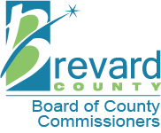
Proposed Conceptual Public Access Plan
South Lake Conservation Area
Brevard County Environmentally Endangered Lands Program
February 27, 2020 - 6:00 pm
Enchanted Forest Sanctuary
Management and Education Center
444 Columbia Blvd.
Titusville, FL 32780

Slide 2
Environmentally Endangered Lands Program
Mission Statement
Vision Statement
Protect and preserve biological diversity through responsible stewardship of Brevard County’s natural resources.
Acquire, protect, and maintain environmentally endangered lands.
Protect Brevard County’s biodiversity.
Provide passive recreation and education opportunities.
Support active volunteers and community involvement.

Slide 3
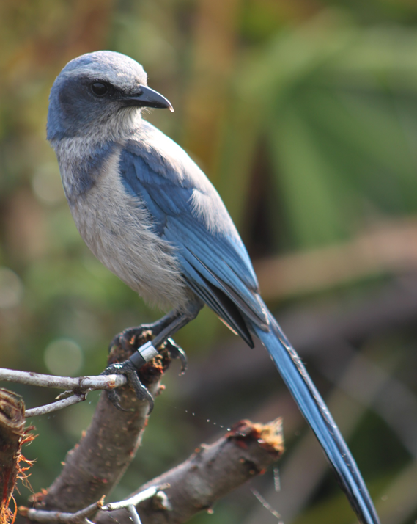
Public Access Plan Approval Process and
Opportunities for Public Comment
Public presentation of the Proposed Public Access Plan for South Lake Conservation Area.
Collect public comments on Public Access Plan.
Public comments are incorporated into the Public Access Plan and reviewed by Brevard County Environmentally Endangered Lands Program’s (EEL) Recreation and Education Advisory Committee (REAC).
Upon REAC approval, the Public Access Plan is incorporated in the draft Sanctuary Management Plan for EEL Selection and Management Committee approval.
All committee meetings are advertised and open to the public.

Slide 4
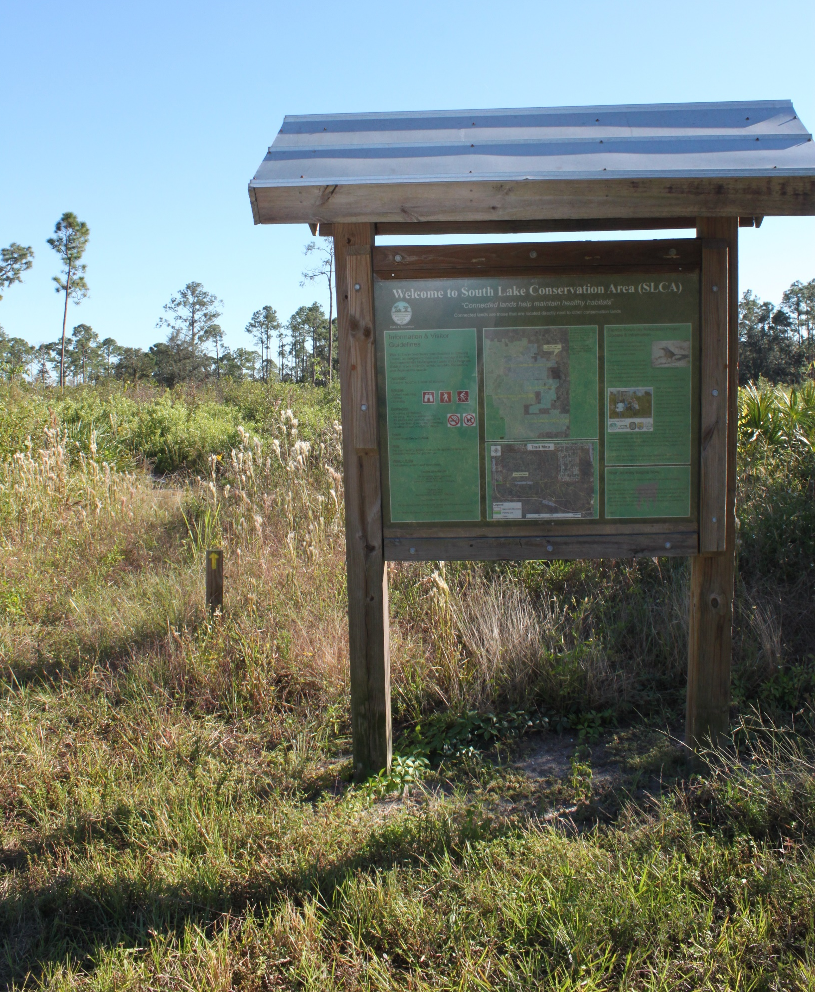
South Lake Conservation Area is a Category 2 Site
Category 2 sites within the Environmentally Endangered Lands Program are managed for intermediate use with minimal capital development. Improvements can include:
  Nature Trails
  Parking Areas
  Interpretive Signs and Kiosks
Public access permitted during daylight hours.

Slide 5
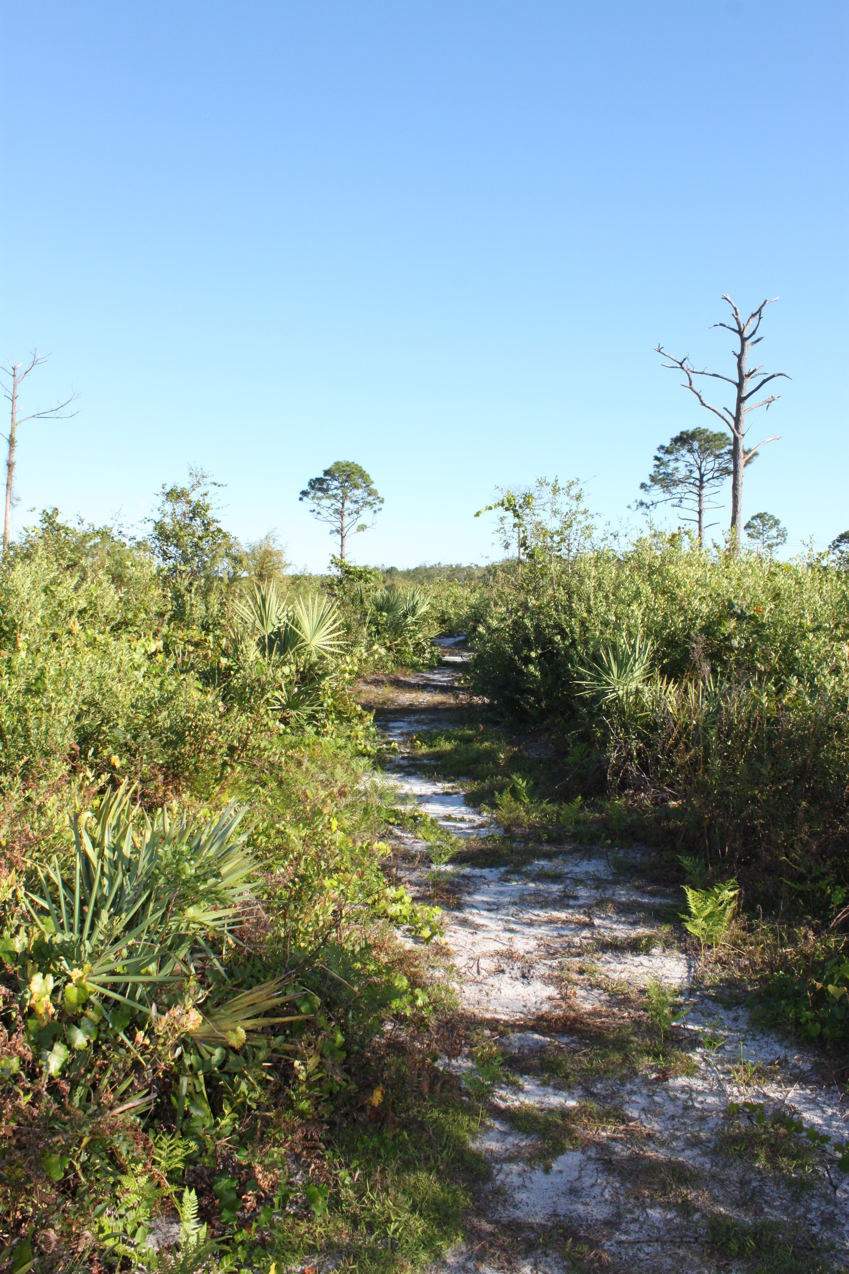
Site Description
Habitat types are oak-saw palmetto scrub, scrubby flatwoods, depression marsh, and hardwood hammock adjacent to South Lake.
Home to many listed plant and animal species such as the gopher tortoise, Florida scrub-jay, Curtiss’ milkweed, and false rosemary.
Location of the first Florida scrub-jay translocations in Brevard County.

Slide 6
Proposed Conceptual Public Access Plan Summary
Existing trail system being modified to avoid fire lines and consistently wet portions of trail. The relatively small size of the site (207 acres), length of planned trail, and the sandy and wet soils support hiking and nature observation as permitted activities, but do not support equestrian use or bicycling. Please see the South Lake Conservation Area Proposed Trail System Map.
0.9 miles of additional trail is proposed for construction, connecting a more recently acquired 52 acre parcel to the northern portion of South Lake Conservation Area. This trail will connect to an existing trail system within Salt Lake Wildlife Management Area. This addition will traverse habitat types not present in the northern portion of the property.
A walkthrough gate will be installed to connect South Lake Conservation Area to Salt Lake Wildlife Management Area south of Dairy Road.
No changes are proposed for existing kiosk locations, existing parking areas, or existing walkthrough gates.

Slide 7
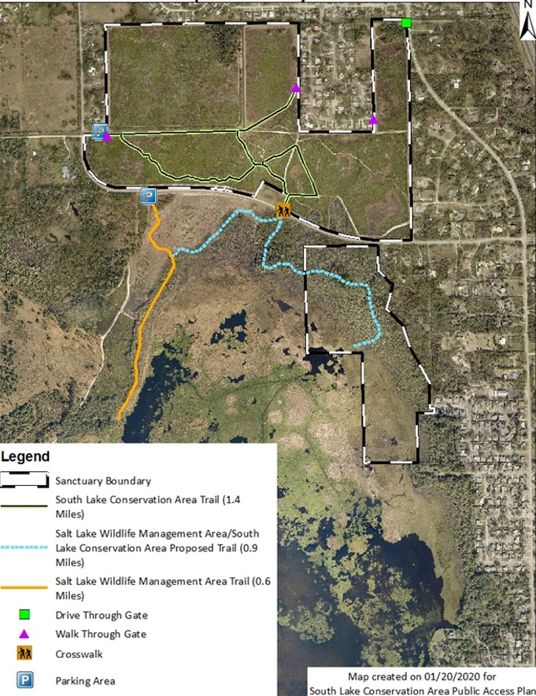
South Lake Conservation Area
Proposed Trail System

